Slide 1

USWDS Monthly Call
May 2023

Slide 2

Hi!
Thanks for being here!

Slide 3
Agenda
Site launches
USWDS 3.5.0
Critical checklists
Real-world accessibility chat
Q&A

Slide 4
Site launches

Slide 5
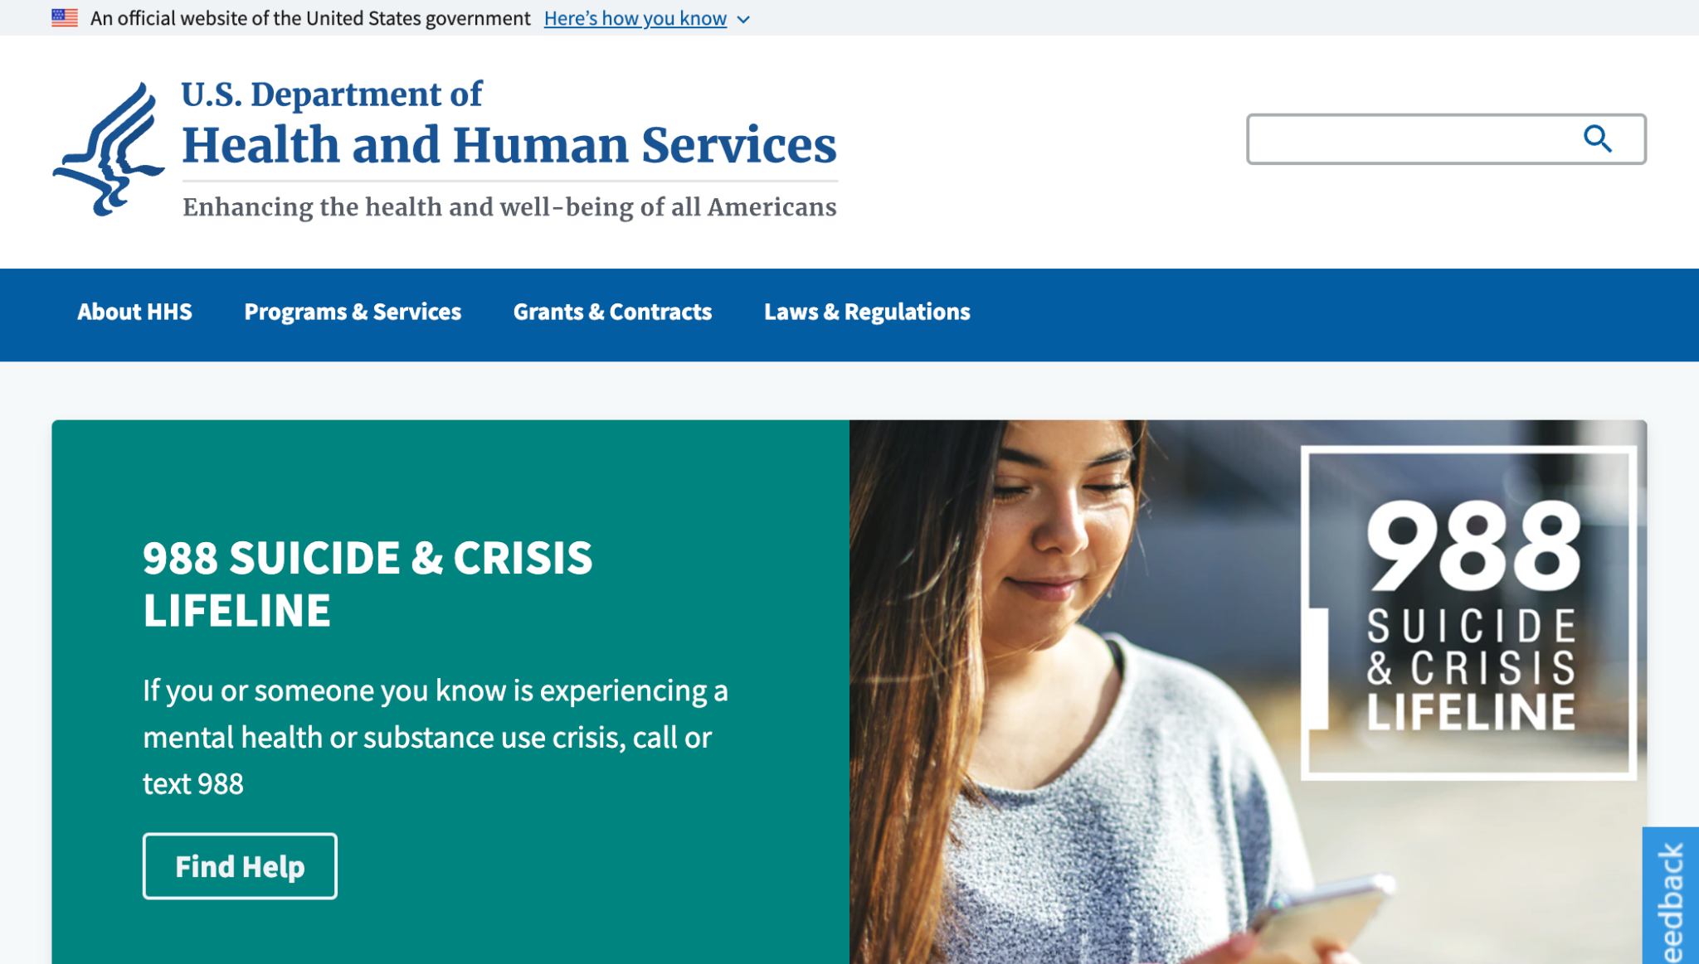
U.S. Department of Health and Human Services
hhs.gov

Slide 6
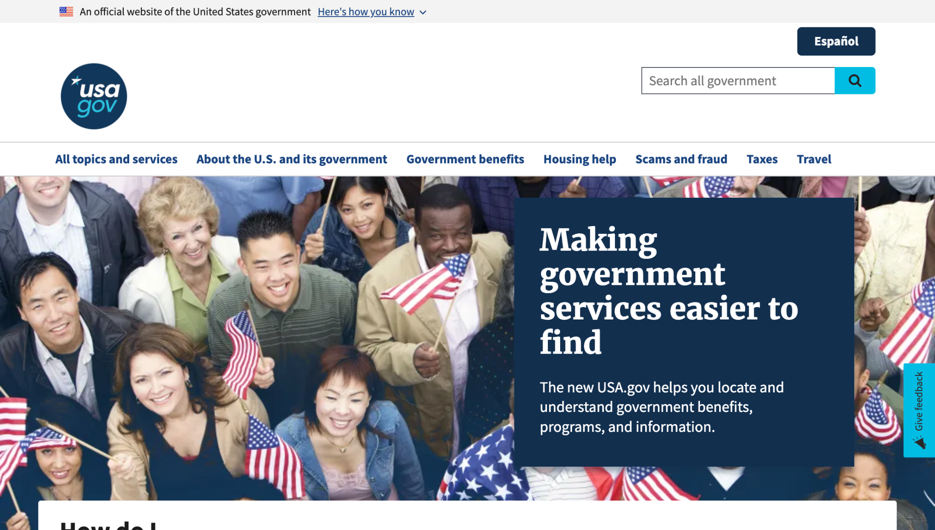
USAGov and USAGov en Español
usa.gov

Slide 7
Great work!

Slide 8
USWDS 3.5.0
Accessibility and usability focus

Slide 9
Key improvements in USWDS 3.5.0
Consistency and legibility of disabled form elements
File input experience for voice and screen readers
Space bar trigger to links styled as buttons
Updated Identifier accessibility link
Updated form guidance to suggest labeling both required fields and optional fields
And a bunch more!

Slide 10
USWDS 3.5.0
Out next week

Slide 11
Amy Cole
she/her
Accessibility Specialist
Contractor

Slide 12
Teams want to know about the Section 508 and WCAG conformance of our components

Slide 13

Not just a simple badge

Slide 14
Component-based
critical checklists

Slide 15
Easy-to-check functional accessibility and usability tests

Slide 16
Outline what all of us can do to validate (and revalidate!) component functionality

Slide 17
We aim to publish at least one of these checklists by next month’s call

Slide 18
We’ll be reaching out to those who expressed interest in providing usability feedback!

Slide 19
Happy Global Accessibility Awareness Day!

Slide 20
Real-world accessibility
What’s it like to be blind and use the web in 2023

Slide 21
Eric Yarberry
he/him
World Services for the Blind

Slide 22
Q&A

Slide 23
Next month
June: Looking at critical checklists
#uswds-public
github.com/uswds
designsystem.digital.gov

